Slide 1
Intro to NodeJS & Socket.io Michael “Mickey” MacDonald Technical Evangelist & Game Developer Microsoft Canada @ScruffyFurn

Slide 2
Lets test it out!
http://ampgame.azurewebsites.net/

Slide 3
The things
Needed:
NodeJS (https://nodejs.org/)
Node Packages:
Express (https://expressjs.com/)
Socket.io (http://socket.io/)
Optional:
Git repo (github, bitbucket, etc…)
VS Code (Visual Studio Code) (https://code.visualstudio.com/)
Azure subscription
(Free Trial! – http://azure.com)
https://github.com/ScruffyFurn/NodeMPDemo
Notes:
Express Fast, minimalist web framework
Socket.io enables realtime, bi-directional communication between web clients and servers. It has two parts: a client-side library that runs in the browser, and a server-side library for node.js
WebSocket is a protocol providing full-duplex communication channels over a single TCP connection

Slide 4
Client
Player.js
Logic for each player
Game.js
Game logic
Manages connection to the remote server.
Input.js
Handles all input
RequestAnimationFrame.js
Used to create our game loop

Slide 5
Server
Server.js
All game/server logic
Handles the sever side of the web socket connections
Player.js
Holds data and functions for the player object

Slide 6
Setting up Git (optional)
$ git init
Initialize the local directory as a Git repository.
$echo "# Add Stuff Here" >> README.md
$ git add .
Add the files in your new local repository. This stages them for the first commit.
$ git commit –m “First commit”
Commit the files that you've staged in your local repository.

Slide 7
Setting up Git (optional)
At the top of your GitHub repository's Quick Setup page, click to copy the remote repository URL.
$ git remote add origin <your url>
Add the URL for the remote repository where your local repository will be pushed.
$ git push --set-upstream origin master
Push the changes in your local repository to GitHub(or other host).

Slide 8
Setting up Git (optional)
.gitignore
# Logs
logs
*.log
npm-debug.log*
# Runtime data
pids
*.pid
*.seed
*.pid.lock
# Directory for instrumented libs generated by jscoverage/JSCover
lib-cov

Slide 9
Setting up NodeJS
Install Node – Installer @ https://nodejs.org/
Ubuntu/Debian users can use sudo apt-get install nodejs
$ npm init
Generate basic skeleton of the package.json
$ npm install <pkg> --save
install a package and save it as a dependency in the package.json file
--save-dev sets the package as a development package only

Slide 10
Installing NodeJS packages
$ npm install express --save
install a Express and save it as a dependency in the package.json file
$ npm install socket.io --save
install a Socket.io and save it as a dependency in the package.json file

Slide 11
Putting it in the cloud
Use our Git repo to provide Continuous Deployment for our server
Web App gives a easy to use, secure, sailable solution.
Free Azure trial to get started
Notes:
We can use our Git repo to provide Continuous Deployment for our server
Using a Web App gives a easy to use, secure, sailable solution – with no IT overhead.
Free Azure trial to get started, with very cost effective options available

Slide 12
Putting it in the cloud
New -> Web + Mobile -> Web App
Add App name (will be used for URL) and Resource group (create new is default)
Select Create

Slide 13
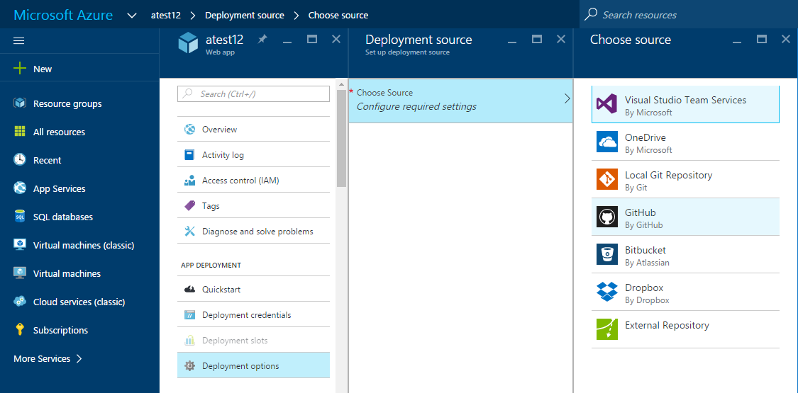
Putting it in the cloud
Select Deployment Options
Choose Source
Authorize/Select project and branch
Don’t forget the Web.config in your repo

Slide 14

Taking it to the next level
http://bit.ly/htmlrpg

Slide 15
Thank you! Happy Coding Michael “Mickey” MacDonald Technical Evangelist & Game Developer Microsoft Canada @ScruffyFurn

